Slide 1
Casual Gaming
Background and Game Features

Slide 2
Intro
Cover the core game mechanics that are in use in modern games
Asses how each could be applied to a casual game and their relevance in a casual game context
Find ways to integrate the mechanics in existing games or new types of casual games

Slide 3
Recommended Reading
Game Design: A book of lenses
Jesse Schell
A Theory of Fun
Raph Koster (available in the ebrary)

Slide 4
Personality Types

Slide 5
Player Types
There are four main “types” of players
Achievers
Explorers
Socializers
Killers
Of course a player can move between each type as time passes
Which type are you targeting?

Slide 6
Player Types
When designing a game remember the game is for a target audience
Not for you
Know your demographics
Design and build your game to meet the main needs of your core demographic
What are these needs?
Certain types of Mechanics

Slide 7
Demographics
0-3 Infants/Toddlers
4-6 Pre-Schoolers
7-9 Kids
10-13 Pre-Teens
13-18 Teens
18-24 Young Adult
25-35 Twenties and Thirties
35-50 Thirties and Forties
50+ Fifty and Up

Slide 8
Demographics
Out of the demographics listed the key demos are
18-24 Young Adult
25-35 Twenties and Thirties
The average game player is 31 years old
And has been playing for 12 years
The average age of the most frequent game purchaser is 35
63% of gamers play with other (local or online)

Slide 9
Demographics
33% of gamers player social games
33% of gamers play on smartphones and 25% play on dedicated handheld gaming consoles
Don’t forget gender
Male vs. Female
52% of gamers are female in the UK. 48% in the US.

Slide 10
Gender
5 things Males like to see in games
Mastery
Must be challenging
Competition
Like to beat others
Destruction
Spatial Puzzles
Males generally have stronger spatial skills (proven)
Trial and Error
Males tend to learn through trial and error rather then accepting help
How many times have your played a game and skipped a tutorial or not read the manual

Slide 11
Gender
5 things Females like to see in games
Emotion
Like experiences that explore the richness of human emotion
Real World
Prefer entertainment that connects meaningfully to the real world
Nurturing
Dialog and Verbal Puzzles
For what females lack in spatial skills they make up for in verbal skills
Learning by Example
Appreciate clear tutorials that lead step by step

Slide 12
Demographics
When designing any game you must be aware of your demographics
The kitchen sink approach will not work
Trying to please everyone by adding a bit of everything
Pick your audience and tailor the experience towards them

Slide 13
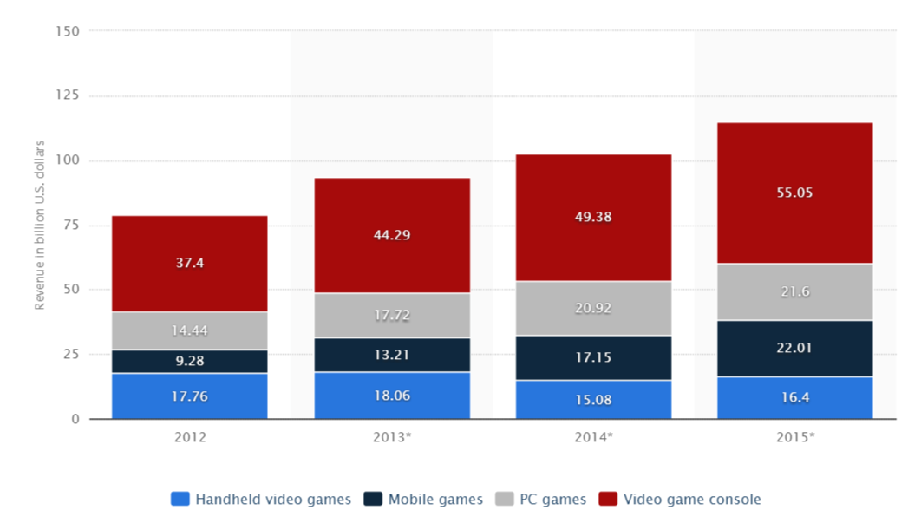
Revenue worldwide

Slide 14
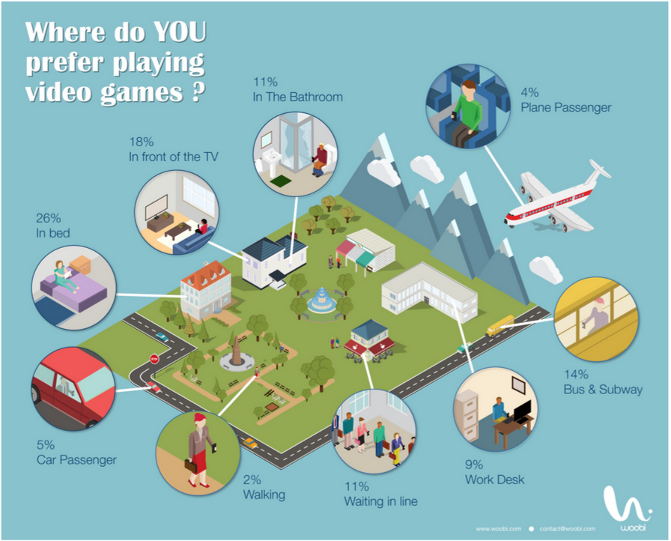

Slide 15
Game Features

Slide 16
Game Features
Before discussing the mechanics of games
Look at features that are now commonly found in almost all modern video and computer games
Identify which features you do not have and which features you need to develop
We will develop some of these features

Slide 17
Activity Feed
Shows players what is/has been happening in the game since they have been away or are not playing
Players can see other players activity and may show players features or task that they were not aware of
Notifications
Toast Notifications

Slide 18
Announcements
In most multiplayer games there are announcements to relay new information to the player
Voice or text
When a player comes online or joins a game their name is announced to the other players

Slide 19
Avatars
Are representations for a player in a game
Usually a customizable character that represents the player
2D or 3D
Games that use avatars have been shown to show high emotional attachment between the player and the game

Slide 20
Leaderboards
Leaderbaords are means for player to track their performance relative to others
Leaderbords are a visual display of a players progress
Can be broken in sub-categories
Global, Local, Friends

Slide 21
Notifier
Used to give the player direct feedback on their progress/status/gameplay
Usually displayed as pop-up messages displayed on the game HUD
Always used to convey important/relevant information to the player

Slide 22
User Profile*
A profile can have multiple uses
Simply showing a players stats and activity on a website or game leaderboard
Keeping track of players progress across multiple devices and platforms
Stored in central location

